Slide 1
In the Words of Mother Teresa...

Slide 2
Blessed Teresa of Calcutta, commonly known as Mother Teresa, was a Roman Catholic Religious Sister and missionary who lived most of her life in India. She founded the Missionaries of Charity, a Roman Catholic religious congregation, which in 2012 consisted of over 4,500 sisters and is active in 133 countries.

Slide 3
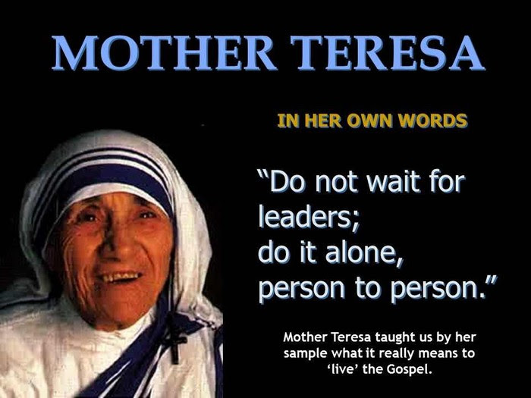

Slide 4
They run hospices and homes for people with HIV/AIDS, leprosy and tuberculosis; soup kitchens; dispensaries and mobile clinics; children's and family counselling programmes; orphanages; and schools. Members of the institute must adhere to the vows of chastity, poverty and obedience, and the fourth vow, to give "wholehearted free service to the poorest of the poor".

Slide 5
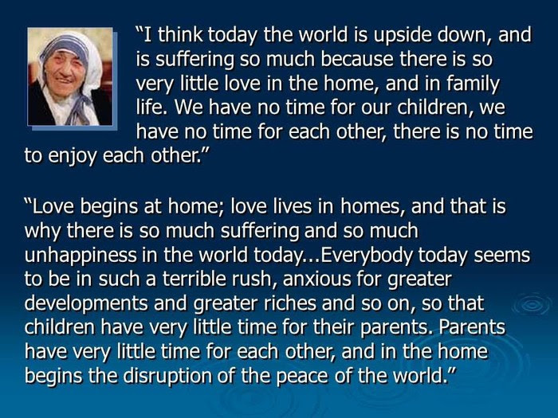

Slide 6
Mother Teresa was the recipient of numerous honours including the 1979 Nobel Peace Prize. In 2003, she was beatified as "Blessed Teresa of Calcutta". A second miracle credited to her intercession is required before she can be recognised as a saint by the Catholic Church.

Slide 7
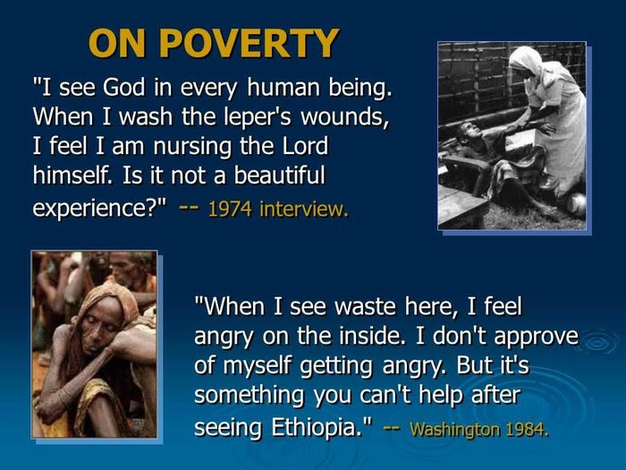

Slide 8
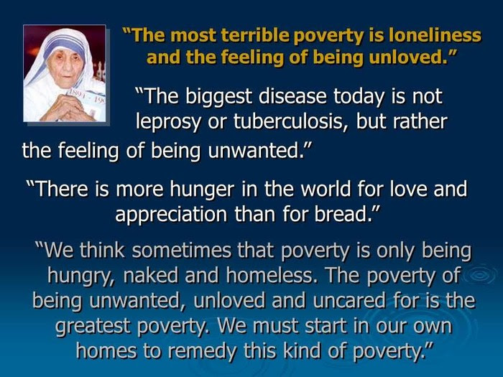

Slide 9
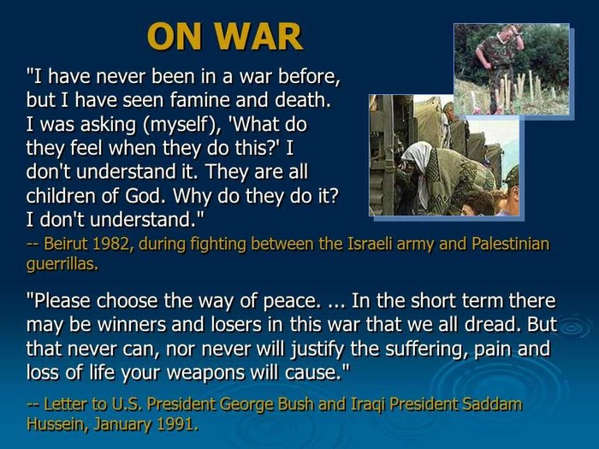

Slide 10
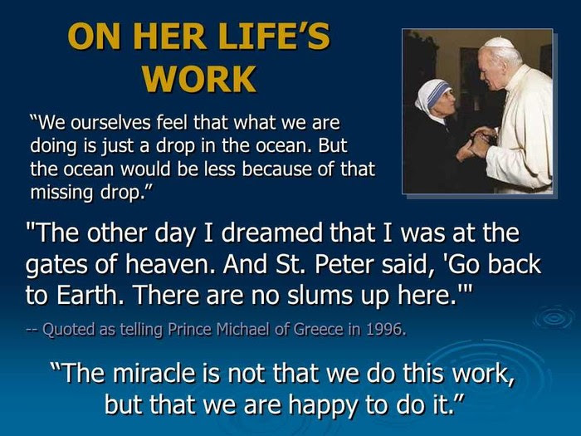

Slide 11
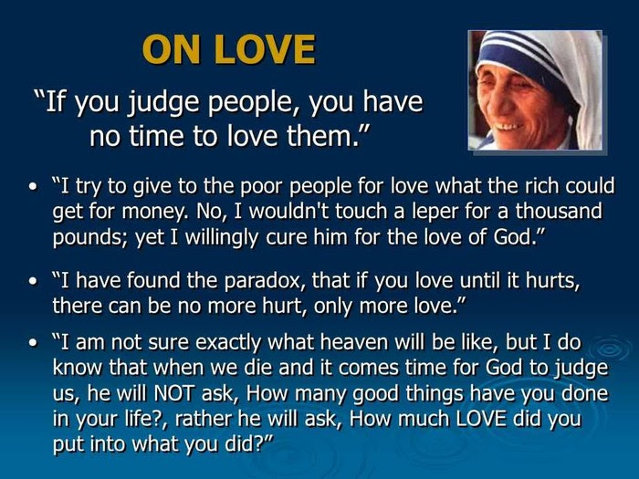

Slide 12
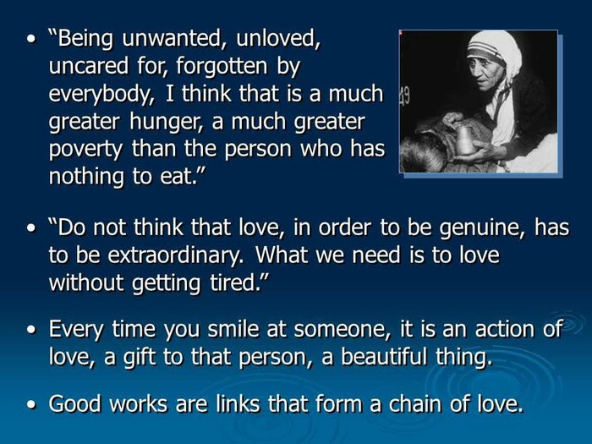

Slide 13
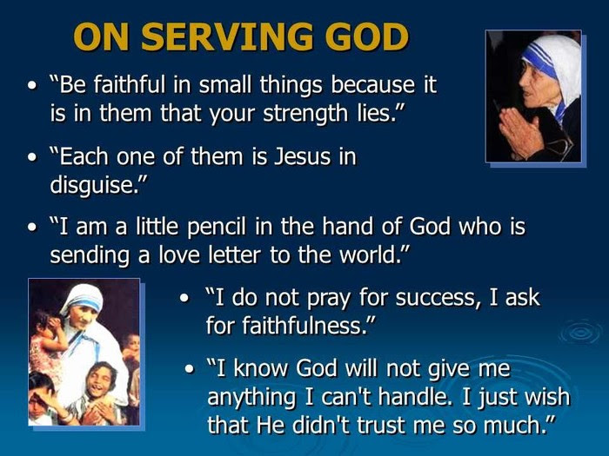

Slide 14
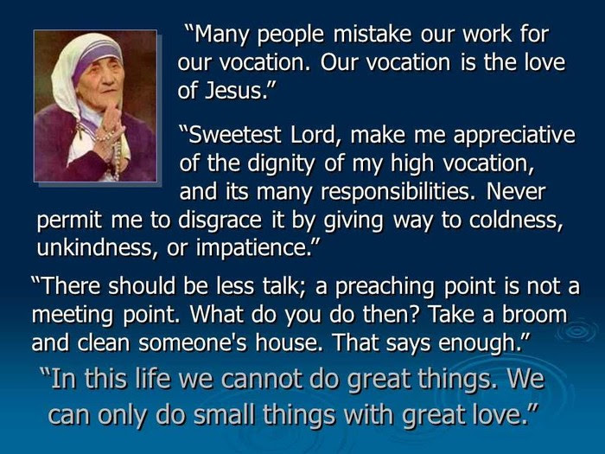

Slide 15
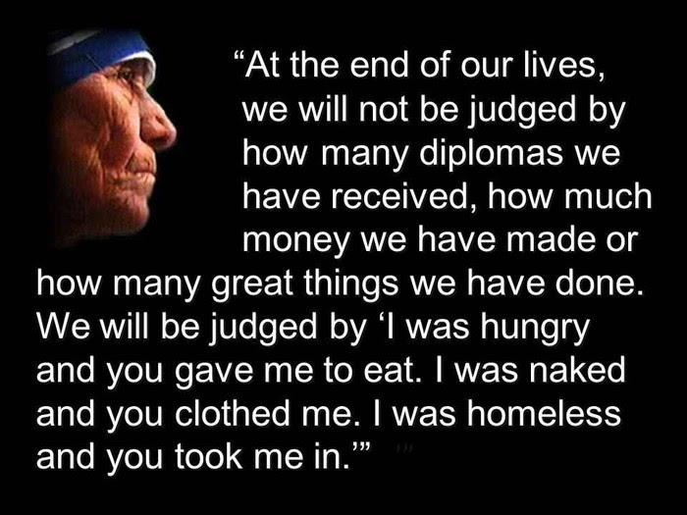

Slide 16
