Slide 1
Art Chennai: Wall art at Stella Maris College, Feb 8, 2014
Photo:: B. Aravind Kumar

Slide 2
Art Chennai 2014 festival
As part of the Art Chennai 2014 festival, a collaborative wall art titled "The Wall and the Skies" was organised at the Stella Maris College for Women. Photos by B. Aravind Kumar

Slide 3
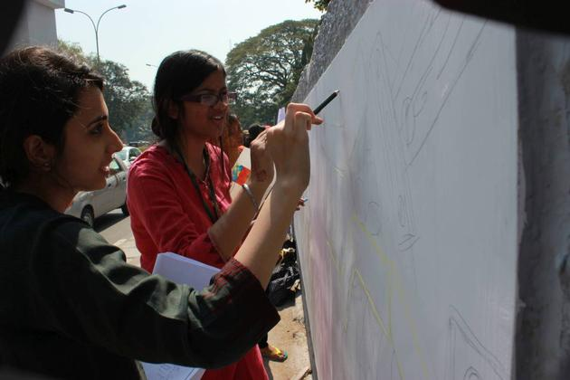
The Wall and the Skies

Slide 4
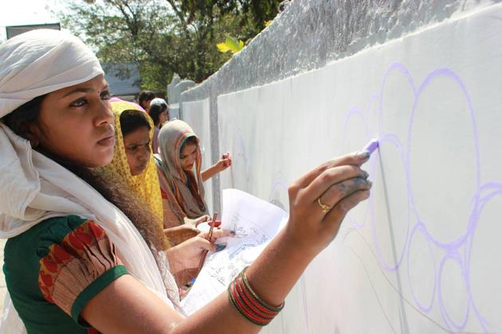

Slide 5
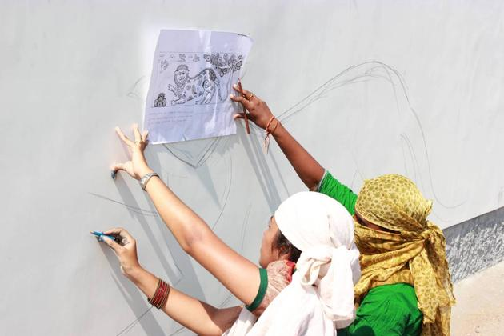

Slide 6
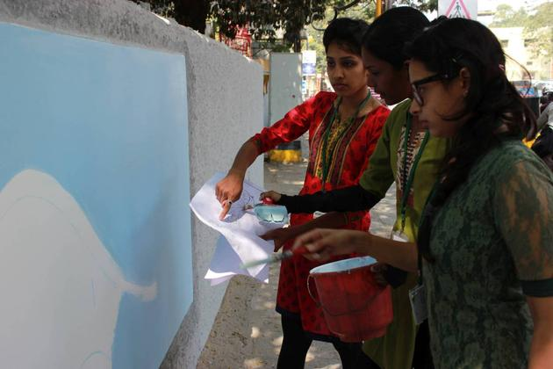

Slide 7
