Slide 1
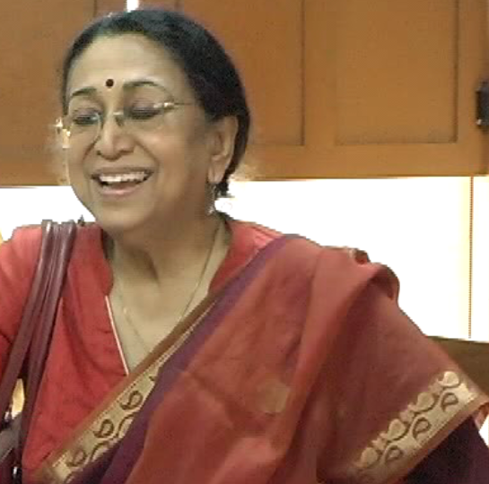
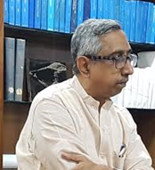
UGC Expert Committee for Extension of Autonomous Status
Dr. M.R.Srinivasan
Dean i/c, College Development Council
University of Madras
Dr. (Ms.) Meenakshi Gopinath
Chair Person
Gita Balachandran
Stellarchives
Stella Maris College

Slide 2
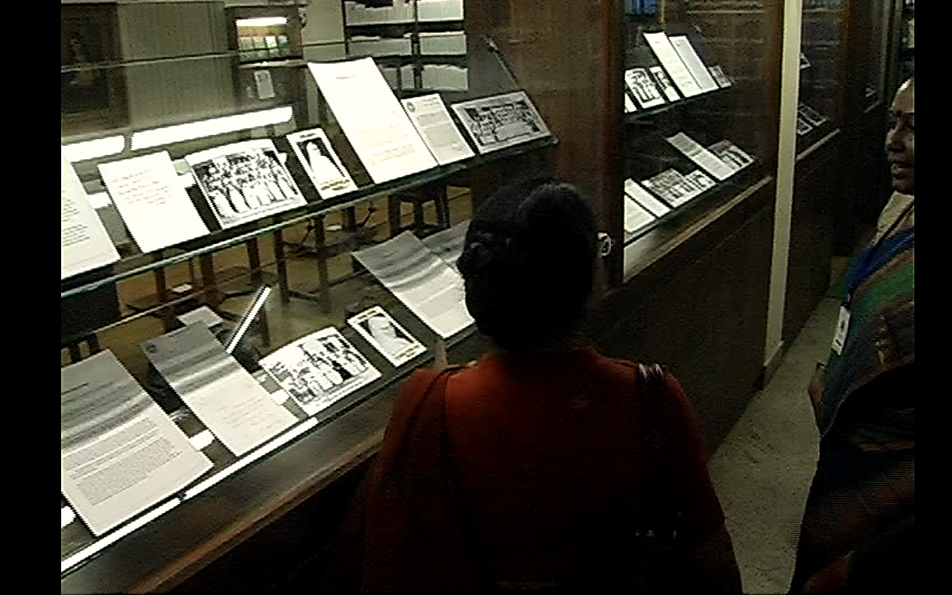
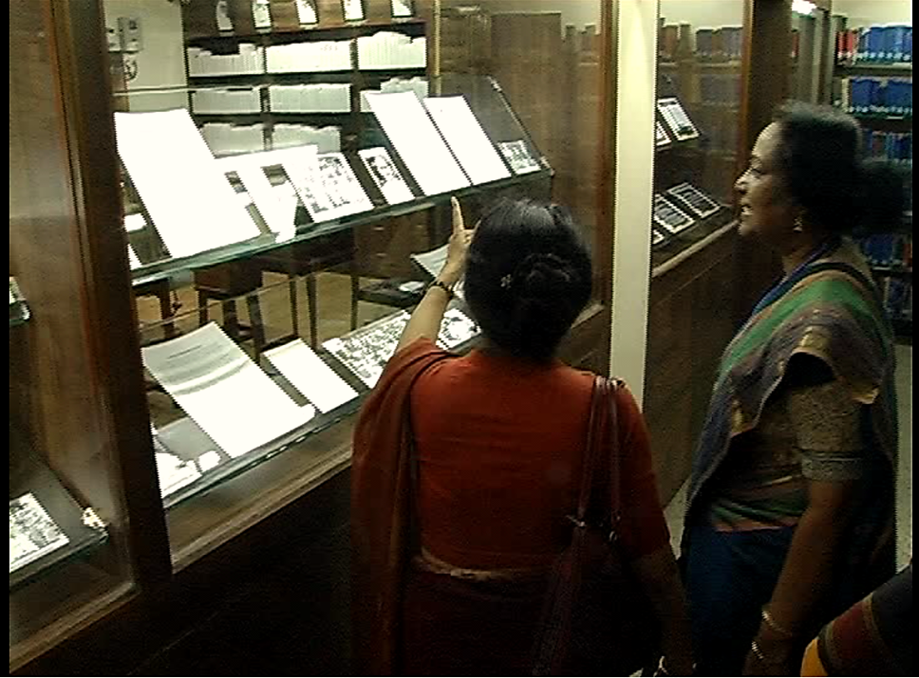
Stellarchives

Slide 3
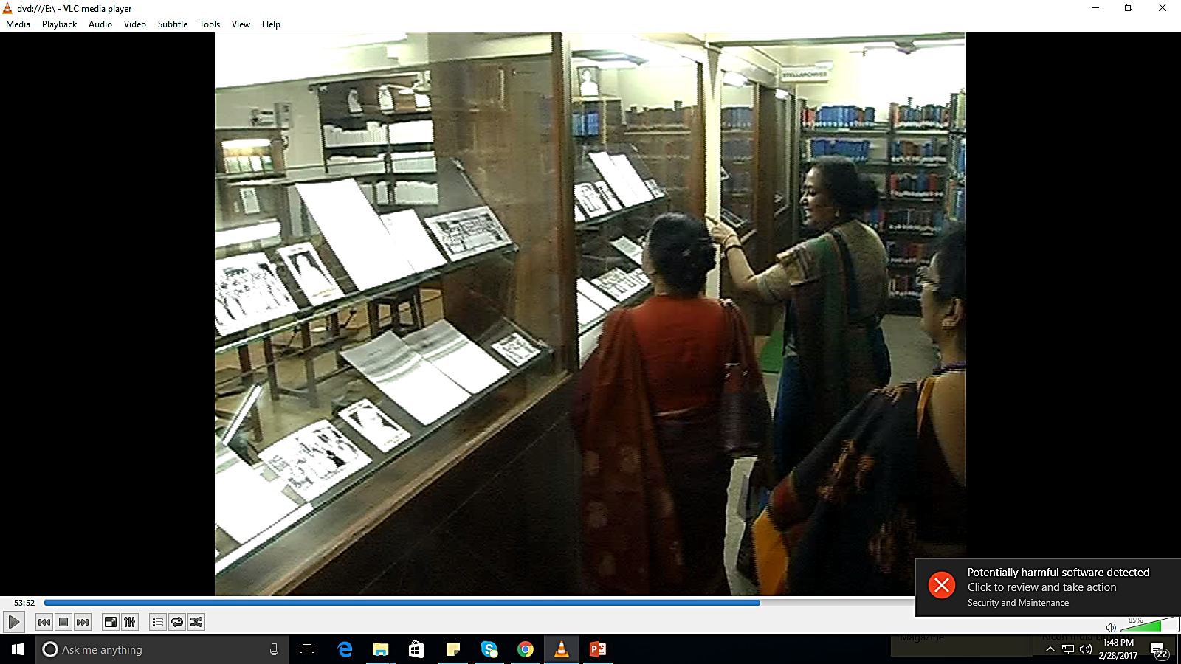
Looking at the display of the various principals-details about them

Slide 4
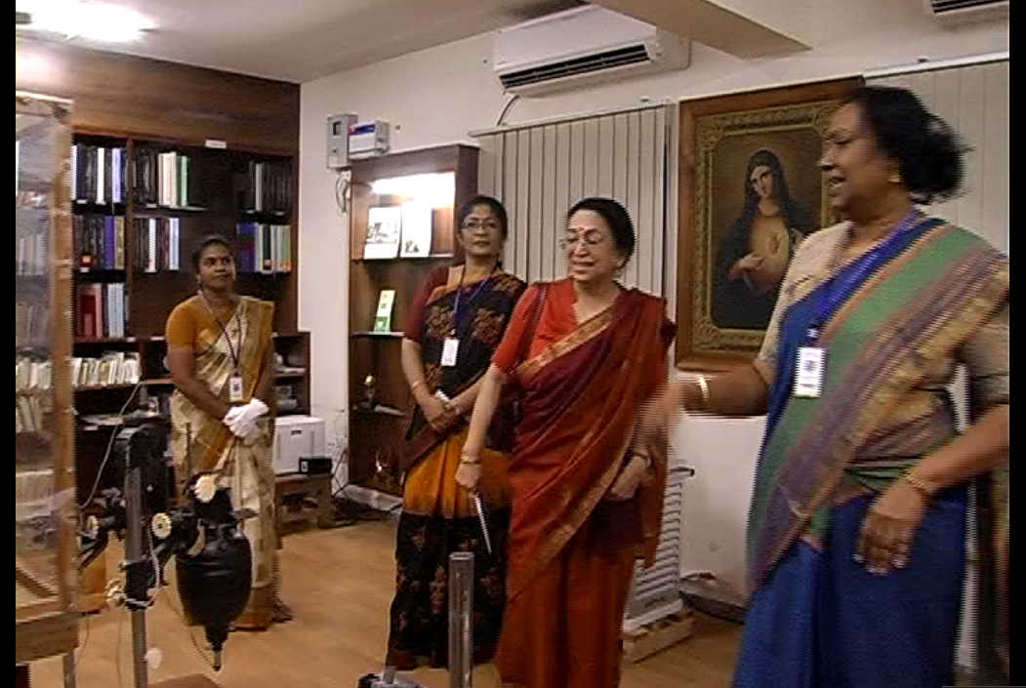
Looking at the photographic equipments used by the physics and Fine arts department

Slide 5
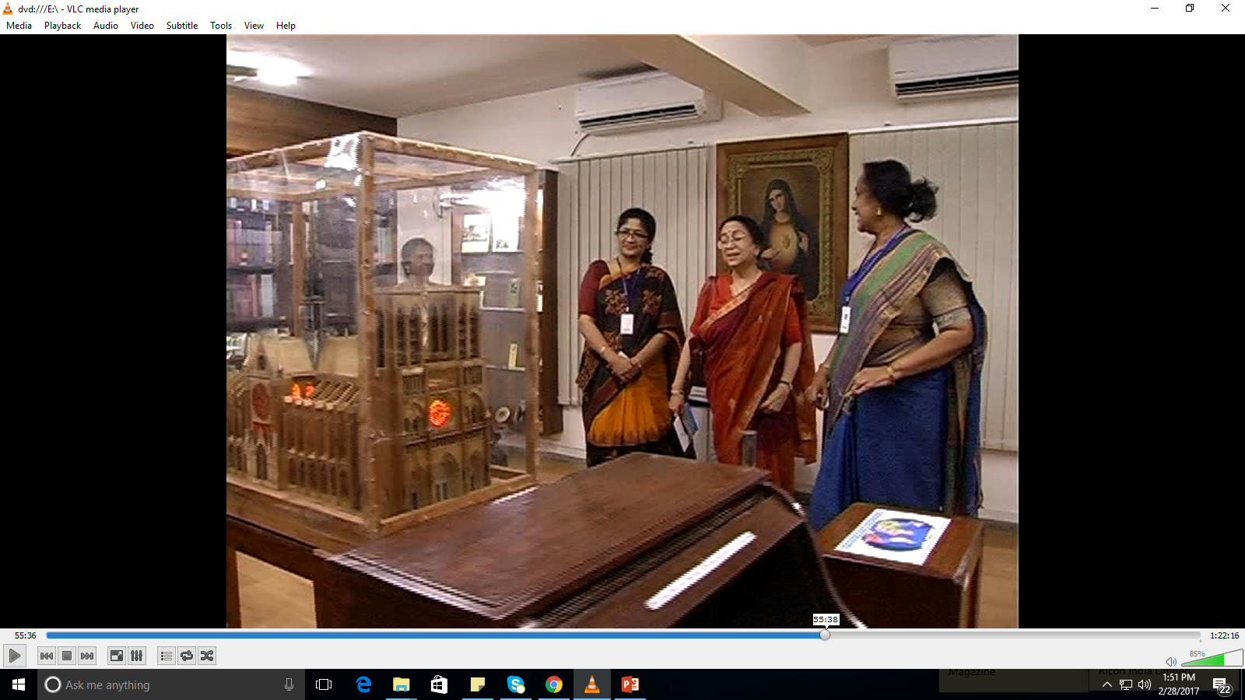
Admiring the wooden model of Notre Dame,Paris made by a fine Arts student

Slide 6
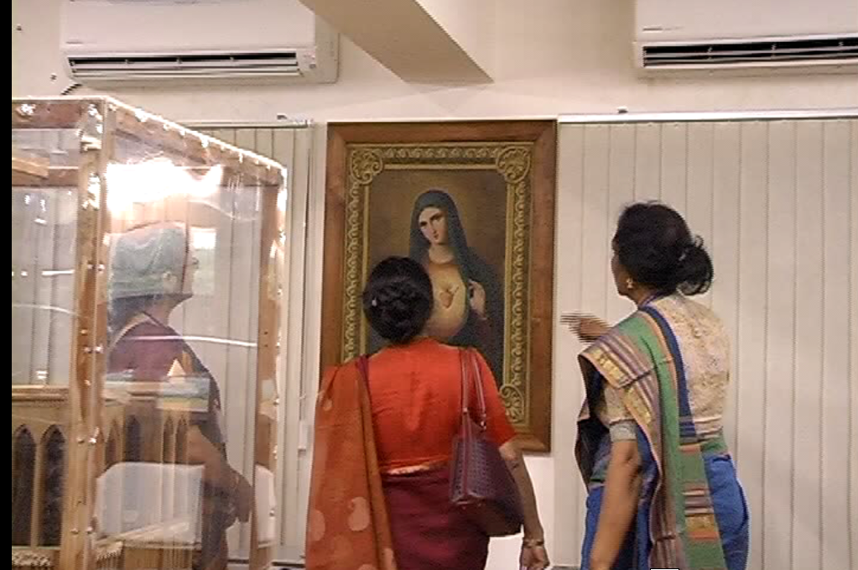
Admiring the Painting of Sr Sylvestra,Fmm

Slide 7
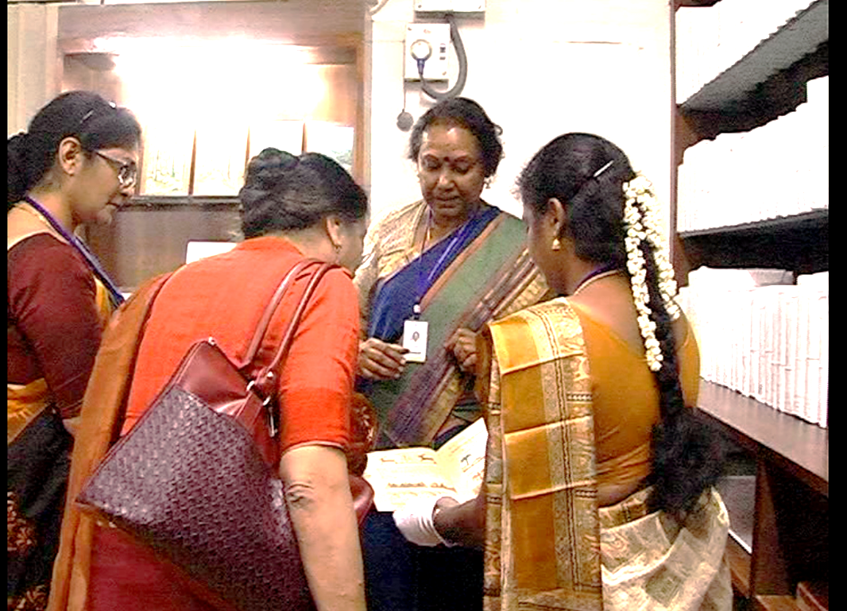
Wonder struck by the hand written books of Sr Sylvestra

Slide 8
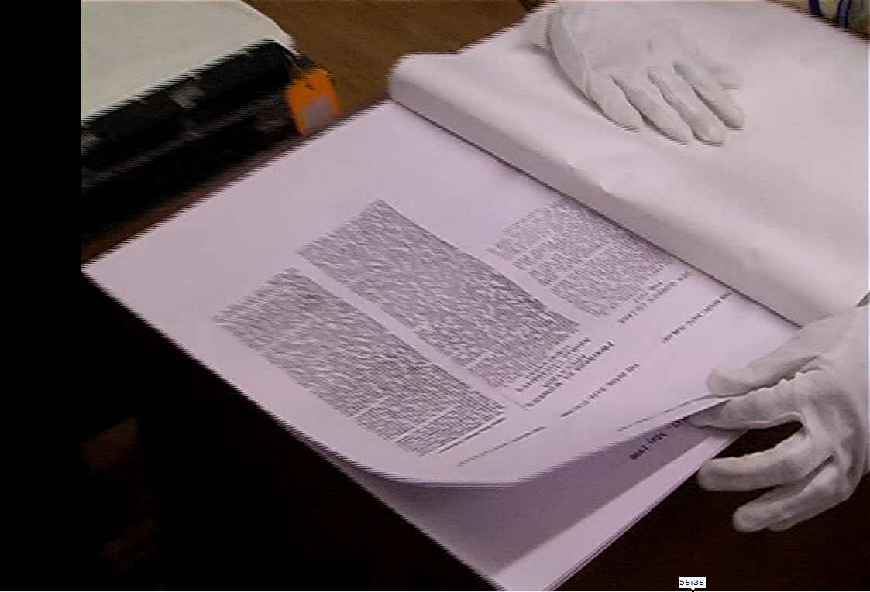
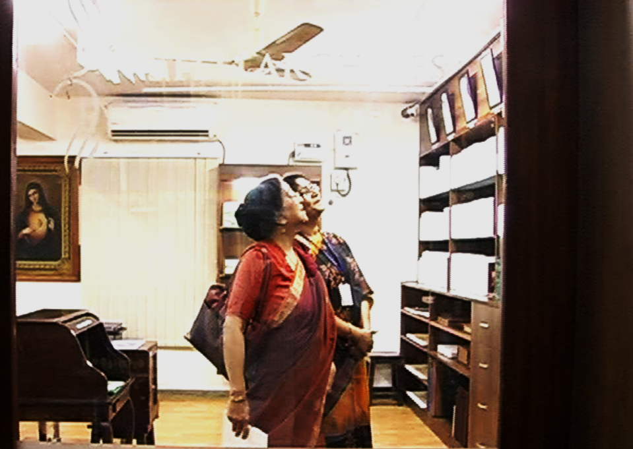
Newspaper clippings and how it is preserved.
Glancing at the principals photo gallery

Slide 9
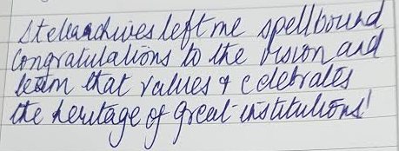
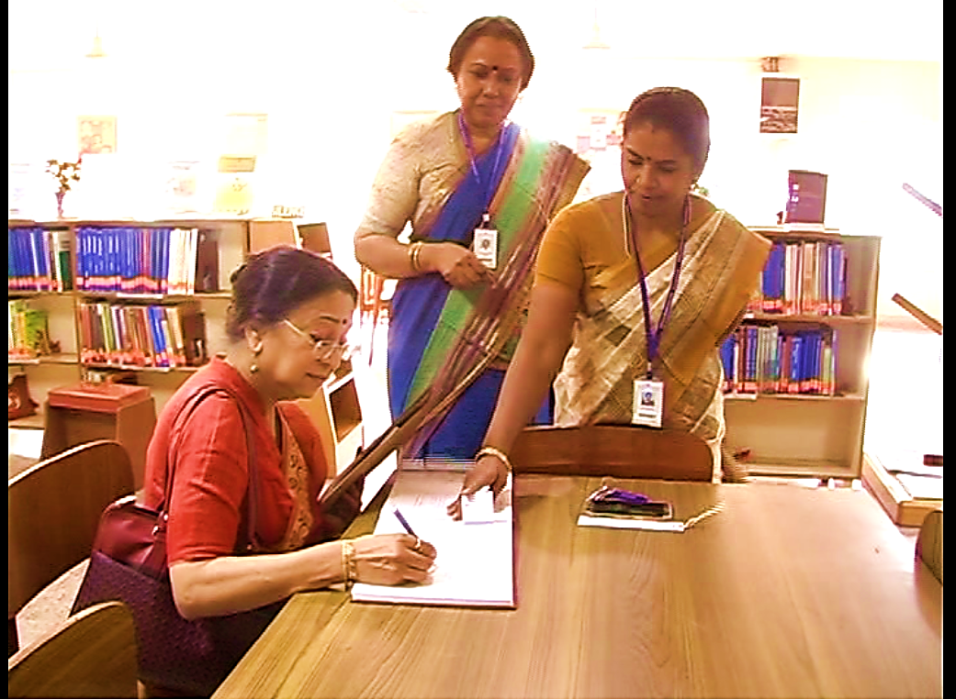
The end of her visit she is signing in the visitors book- her comments

Slide 10
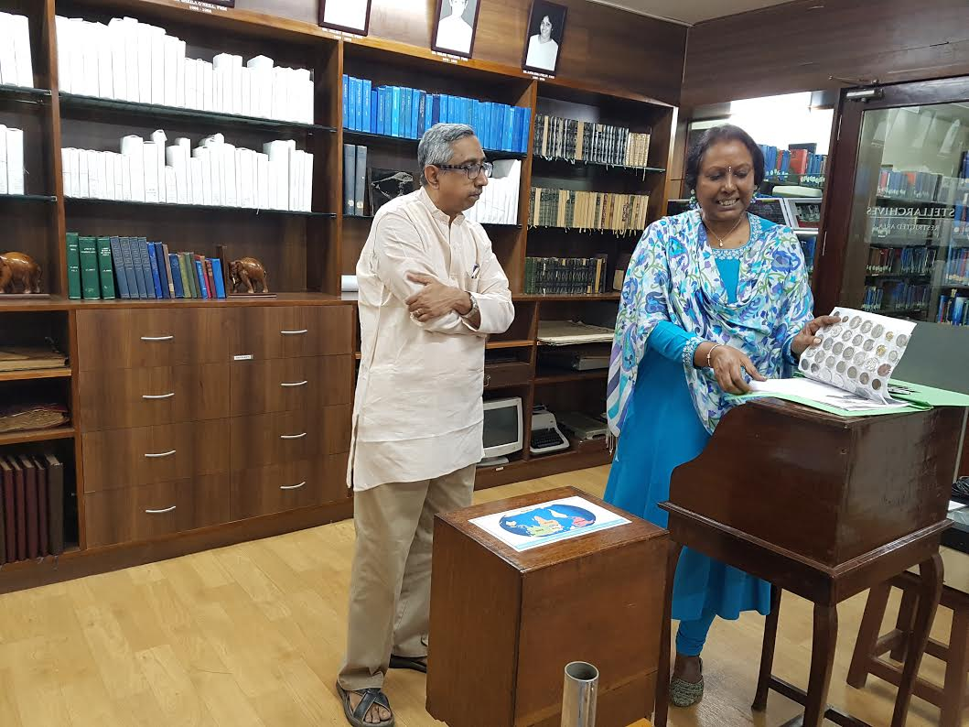
Looking at the coin collection and how it is preserved

Slide 11
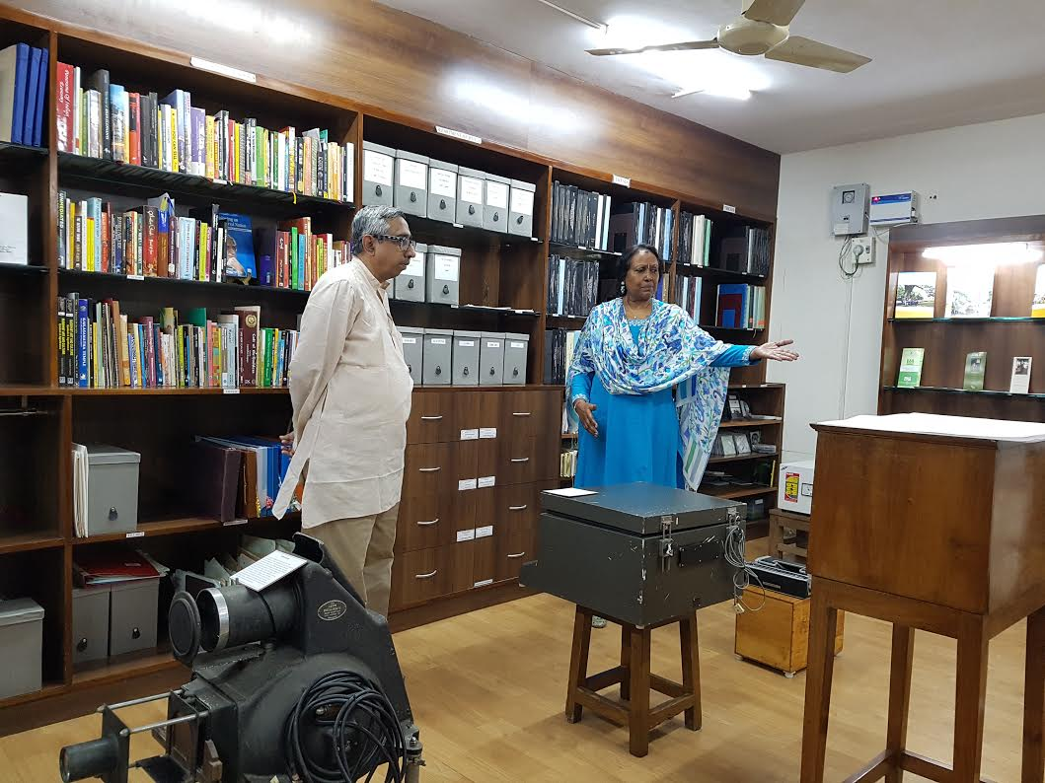
Having a look at all artifacts preserved

Slide 12
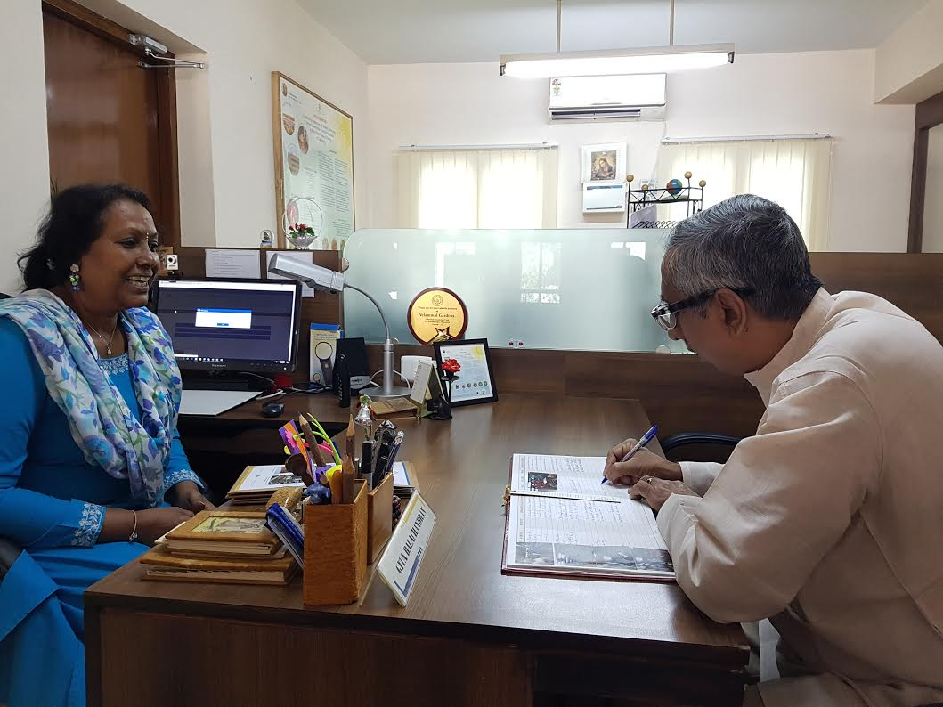
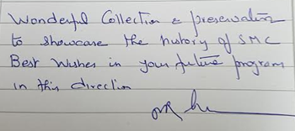
Finally his comments in our visitors book

