Slide 1
Hope for the World
Department of Fine Arts
Stella Maris College
14.03.2017

Slide 2
Hope for the World
Murals to be painted on the façade of Stella Maris College Campus walls
Recent environmental disasters such as the flooding of the city, cyclone Vardah, and the oil spill off our coast have set minds thinking. In a bid to sensitize people to the concerns about man’s impact on nature, twenty-eight panels on the exterior walls of Stella Maris College, which created a sensation a few years ago during Art Chennai, will once again become traffic stoppers! Stella Maris College has sought to inculcate in her students the need to care for, and preserve the environment. ‘Hope for the World’ is a mural project by the department of Fine Arts which will depict the changing relationship between man and nature.

Slide 3
Hope for the World
Whilst depicting man’s oneness with Nature, the painted panels will illustrate the hostility that man has inflicted upon her through deforestation, escalation of technology, exploitation of resources, and so on. Imagery derived from the folk idiom will be interspersed with evocative quotes in the hope of inspiring Chennai to respect and preserve her beautiful environs. Two hundred students, both under-graduate and post-graduate, will paint approximately1500 square feet on this theme of hope, in a bid to create awareness of our distressing situation. The project, which will be executed between 14-20 March 2017 is supported by Mr. Sanjay Tulsyan of Gallery Veda.

Slide 4
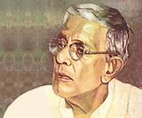
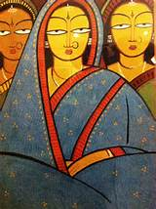



Jamini Roy
Jamini Roy (11 April 1887 – 24 April 1972) was an Indian painter. He was honoured with the State award of Padma Bhushan in 1955.

Slide 5
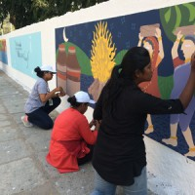
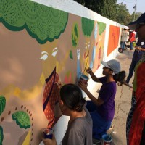
Paintings are inspired by Jamini Roy’s style of painting

Slide 6
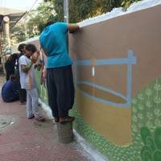
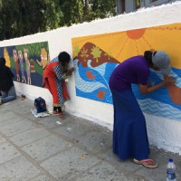
Hope for the World

Slide 7
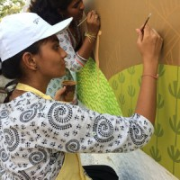
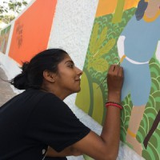
Hope for the World

Slide 8
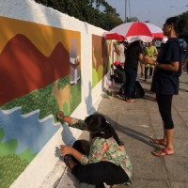
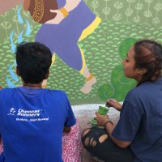
Hope for the World

Slide 9
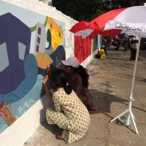
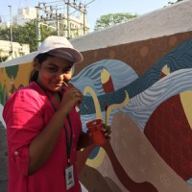
Hope for the World

Slide 10
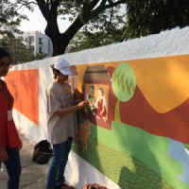
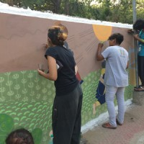
Hope for the World

Slide 11
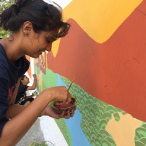
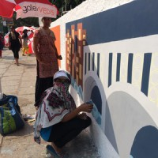
Hope for the World

Slide 12
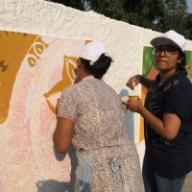
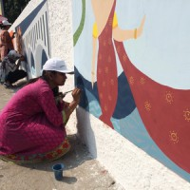
Hope for the World

