Slide 1

PASCHA
The Passion, Death and Resurrection of
Jesus

Slide 2

CHRISTOLOGICAL TIMELINE
The Pascal Event
Pre Pascal Period
Post Pascal Period

Slide 3

Canonical Gospels
MATHEW
MARK

Slide 4

Canonical Gospels
LUKE
JOHN

Slide 5
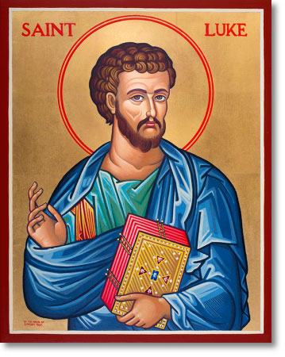
Luke the Evangelist

Slide 6
Luke the Evangelist
The only Gentile/non-Jewish evangelist (Luke’s Jesus is “a light for revelation to the Gentiles and for glory to your people Israel.” 2:32)
His home town – Antioch in Syria
A physician
One of the travelling companions and fellow workers of Paul (Col 4:14; Phil 1:24)
A cultured man, could write beautiful Greek, and varied his style to suit his subject

Slide 7
Date of the Gospel of Luke
Authors in ancient times did not date their books
So exact date not known
Luke knew and used Mark which was written around 64-65 CE
From internal evidences the Gospel of Luke has been dated by most biblical scholars somewhere between 80 and 85CE

Slide 8
Structure of Luke’s Gospel
Clue – introduction – states that he has studied all that had been written about Jesus already
Sets out to give an orderly account
Mark’s Gospel has certainly been used – about half of it and in almost the exact language and same order
About 200 verses consisting of the teachings of Jesus which is common to Matthew as well – from the ‘Q’ source

Slide 9
What is unique to Luke
After all these sources have been accounted for, there is still half the Gospel left. This material occurs nowhere else and adds richness and beauty to his Gospel:
Two of the best parables of Jesus – the Good Samaritan and the Prodigal Son
The song of praise by Mary / the Magnificat
The song of Simeon / Nunc Dimittis
The incident on the road to Emmaus (“The most beautiful story in the world” George Eliot)

Slide 10
Luke’s purpose in writing the Gospel and the Acts
To present Jesus as the Saviour for both Jews and Gentiles, in short for all humanity.
A second motive to show the Roman authorities that they had nothing to fear from the new religion. (Pilate tries to secure the release of Jesus 23:4 and 14-15. Similarly in the Acts too Festus, the Roman Governor, in spite of much pressure from the Jews, would not condemn Paul – Acts 26:31.

Slide 11
In praise of Luke
St Jerome: “As often as the book of Luke the Physician is read in the church, so often does the medicine flow.”
Dante: Luke is “the writer of the meekness of Christ.”
Renan: “Luke’s Gospel is the most beautiful book ever written.”
A.H.McNeille: “The keynote in Matthew is royalty, in Mark power and in Luke it is Love.”

Slide 12


Infancy narrative in Matthew &Luke Differences (Mt 1 & 2; Luke 1 & 2)
Mathew | Luke
Genealogy of Jesus 1: 1-17 | __________
__________ | Announcement and birth of John the Baptist
Announcement of Jesus’ birth by an unnamed angel of the Lord to Joseph 1: 18-25 | Announcement of Jesus’ birth to Mary by angel Gabriel 1: 26-38

Slide 13
The birth of Jesus 2: 1 – Herod is King | The birth of Jesus 2: 1-7 Emperor Augustus orders a census. Quirinius is Governor of Syria
The visit of the Magi 2: 1-12 | __________
__________ | The visit of the shepherds 2: 8-20

Slide 14
__________ | The naming of Jesus and the presentation in the Temple 2: 21-38
The Escape to Egypt 2: 13-15 | __________
The Massacre of the Innocents 2: 16-18 | __________

Slide 15
Return from Egypt to Nazareth 2: 19-23 | __________
__________ | Return from Jerusalem to Nazareth 2: 39-40
__________ | The finding of the boy Jesus at 12 years in the Temple 2: 41-52

Slide 16
The different motives of the two evangelists
Matthew seeks to stress the fulfilment of the Old Testament prophecies
Luke tries to emphasize the parallelism of God’s intervention in the conception and birth of John the Baptist and Jesus.

Slide 17
Similarities between Matthew and Luke’s infancy narratives
Jesus’ birth related to the reign of Herod the Great
(Mt 2: 1; Lk 1: 5)
Mary, his mother to be, is a virgin engaged to Joseph, but they have not yet come to live together
(Mt 1: 18; Lk 1: 27, 34, 2: 5)
Joseph is of the house of David
(Mt 16: 20; Lk 1: 27; 2: 4)
An angel announces the coming conception and birth of Jesus
(Mt 1: 20-21: Lk 1: 28 – 30)

Slide 18
Similarities between Matthew and Luke’s infancy narratives
Jesus himself is recognised to be a son of David
(Mt 1: 1; Lk 1: 32)
His conception is to take place through the Holy Spirit
(Mt 1: 18, 20; Lk 1: 35)
Joseph is not involved in the conception
(Mt 1: 18-25; Lk 1: 34)
The child is born in Bethlehem
(Mt 2: 1; Lk 2: 1-7)

Slide 19
Similarities between Matthew and Luke’s infancy narratives
The name “Jesus” is designated by heaven prior to his birth
(Mt 1: 21; Lk1: 31)
Heaven identifies Jesus as “Saviour”
(Mt 1: 21; Lk2: 11)
Jesus is born after Joseph and Mary come to live together
(Mt 1: 24-25; Lk2: 4-7)
Jesus is born in Bethlehem
(Mt 2: 1; Lk2: 4-7)
Jesus settles with Mary and Joseph in Nazareth and Galilee
(Mt 2: 22-23; Lk2: 39, 51)

Slide 20

Infancy Narrative – Artistic Design
A Diptych

Slide 21
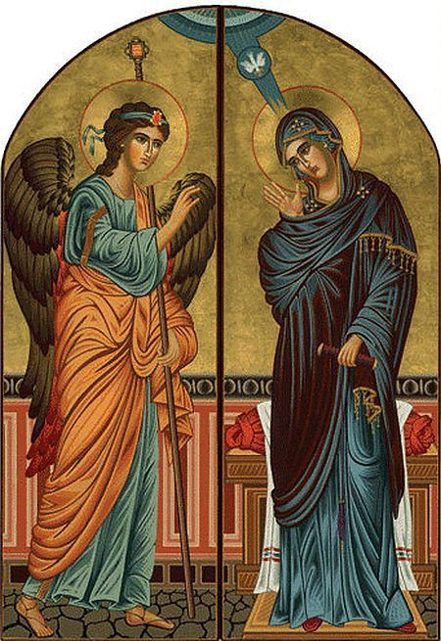
Infancy Narrative – Artistic Design
A Diptych

Slide 22
Parallelisms in the Lucan Infancy Narrative
John the Baptist | Jesus
Announcements of conception of JtB – 1: 5-23 | Announcements of conception of Jesus – 1: 26-38
Circumcision and manifestation of JtB – 1: 59-80 | Circumcision and manifestation of Jesus 2: 21

Slide 23
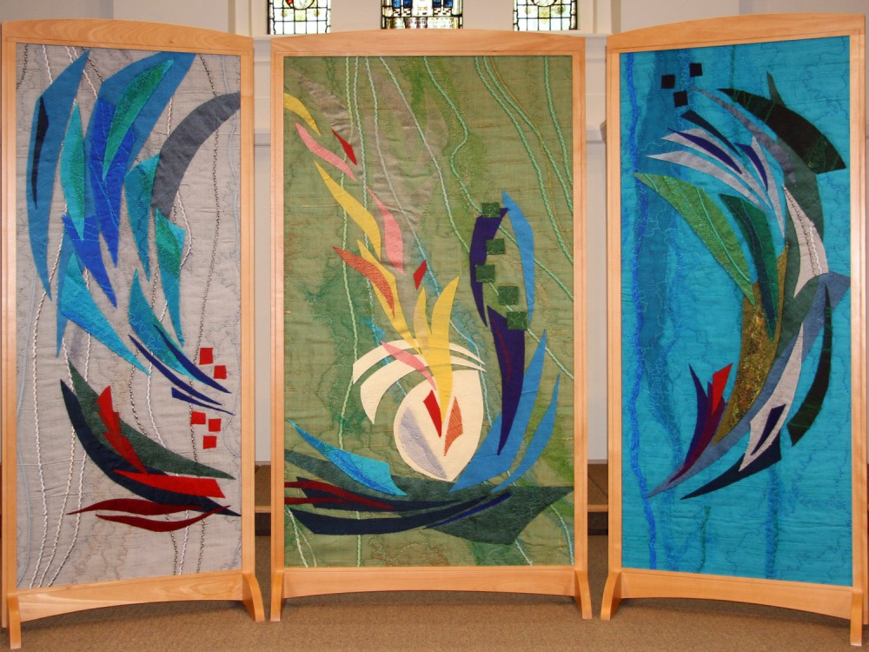
Infancy Narrative – Artistic Design
A Triptych

Slide 24
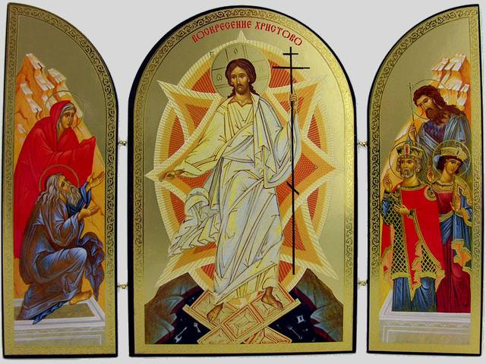
Infancy Narrative – Artistic Design
A Triptych

Slide 25
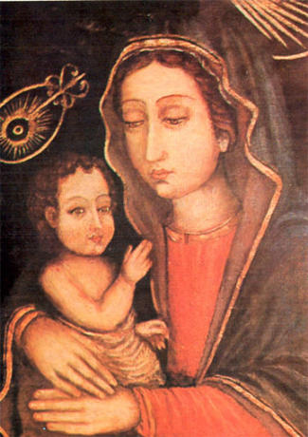
Luke’s painting of Mary and Jesus

Slide 26
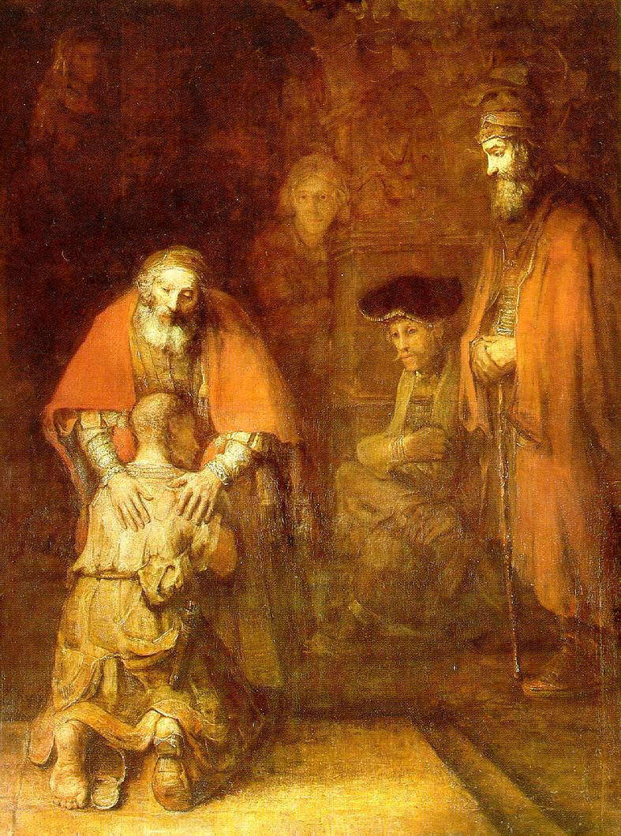
Rembrandt’s
Prodigal Son/ Merciful Father

Slide 27

We are an Easter People. Alleluia is our Song.
-Augustine

