Slide 1
FUZZYNESS :
A PARADIGM SHIFT
Felbin C. Kennedy 20-12-2018
Head, Department of Mathematics
Stella Maris College, Chennai
MATHFIESTA
QMAC Mathematics Association

Slide 2
EDUCATION
EDUCATION - The process or art of imparting knowledge, skill and judgment
EDUCATION means 'to draw out', facilitating realization of
self- potential & latent talents of an individual

Slide 3
EDUCATION
EDUCATION is a weapon whose effects depend on who holds it in his hands & at whom it is aimed
Education is the manifestation of the perfection
already in man
  - Swami Vivekananda
Intelligence plus character – that is the goal of
real education
  - Martin Luther King, Jr

Slide 4
MATHEMATICS
is a coherent, consistent and
growing body of science
which makes use of a specific
language and skills to model,
analyze, and interpret the world
provides a means of communication
which is concise, and powerful

Slide 5
Motivation
Role of Mathematics –
quantify objects of nature and
the phenomena occurring in the
universe
Role of Mathematicians –
urge to formulate quantifiers

Slide 6
Historical Evidence of Existence
Most ancient Mathematical texts available :
Babylonian mathematics ca. 1900 BC –
Plimpton 322
Egyptian mathematics ca. 1850 BC –
Moscow Mathematical Papyrus
Egyptian mathematics ca. 1650 BC
Rhind Mathematical Papyrus
Indian mathematics ca. 800 BC - Shulba Sutras

Slide 7
Technology enabled
Teaching & Learning
To equip the students with more technical and technological skills and scientific computing techniques based on mathematical methods to meet the growing demand in the industrial, marketing, communication sectors etc.

Slide 8
Technology enabled
Teaching & Learning - ICT
Smart Class
Wikis & New Tech.
Blogs
Pod Casts
e-Learning
Multimedia
Simulations
On-line learning tracks

Slide 9
Curriculum Framework aims : to foster and develop mathematical talent
Communication skills
Numeracy skills
Information skills / data graphics
Problem-solving skills
Self - study skills
Social and co-operative skills / decision
Physical skills
Work and study skills

Slide 10
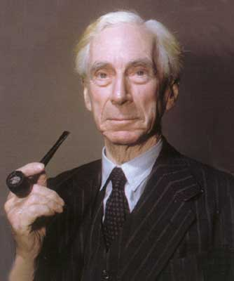
  All traditional logic habitually assumes precise symbols that are being employed. It is therefore not applicable to this terrestrial life but only to an imagined celestial existence
  B.Russel
  Vagueness , Australian J. Psychology
  and Philosophy ( 1923) 1 (pg. 84-92)

Slide 11
Menger in 1942 introduced the notion of probabilistic metric which was developed by Schweizer and Sklar in 1960 with more satisfying mathematical details, depending on concepts like distribution function, random variable and the like. Possibly to make things mathematically simpler distribution functions were assumed to be continuous on ℜ taking values between 0 and 1, taking the value 0 at 0 and 1 as the variable ∞

Slide 12
It was felt later that even this requirement forces too much of regularity which is seldom found in nature.
This feeling made Lofti A. Zadeh in 1963 to formulate the idea of a fuzzy set. Lot of development has taken place using this concept thrown by Zadeh encompassing a number of disciplines viz., Set Theory, Logic, Differential equations Algebra, Analysis, Topology ...

Slide 13
Representation of a SET
A set X is characterized by a
Characteristic Function defined by
a function

Slide 14
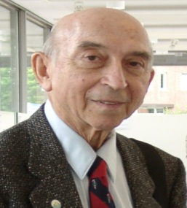
Fuzzy sets, (1965), Inform. and Control. 8, 338 - 353
As the complexity of a system increases, our ability to make precise & yet significant statements about its behaviour diminishes until a threshold is reached beyond which precision & significance (relevance) become almost mutually exclusive characteristics
L.A.Zadeh
Memorandum ERL – M411,
Berkeley, (1973)

Slide 15
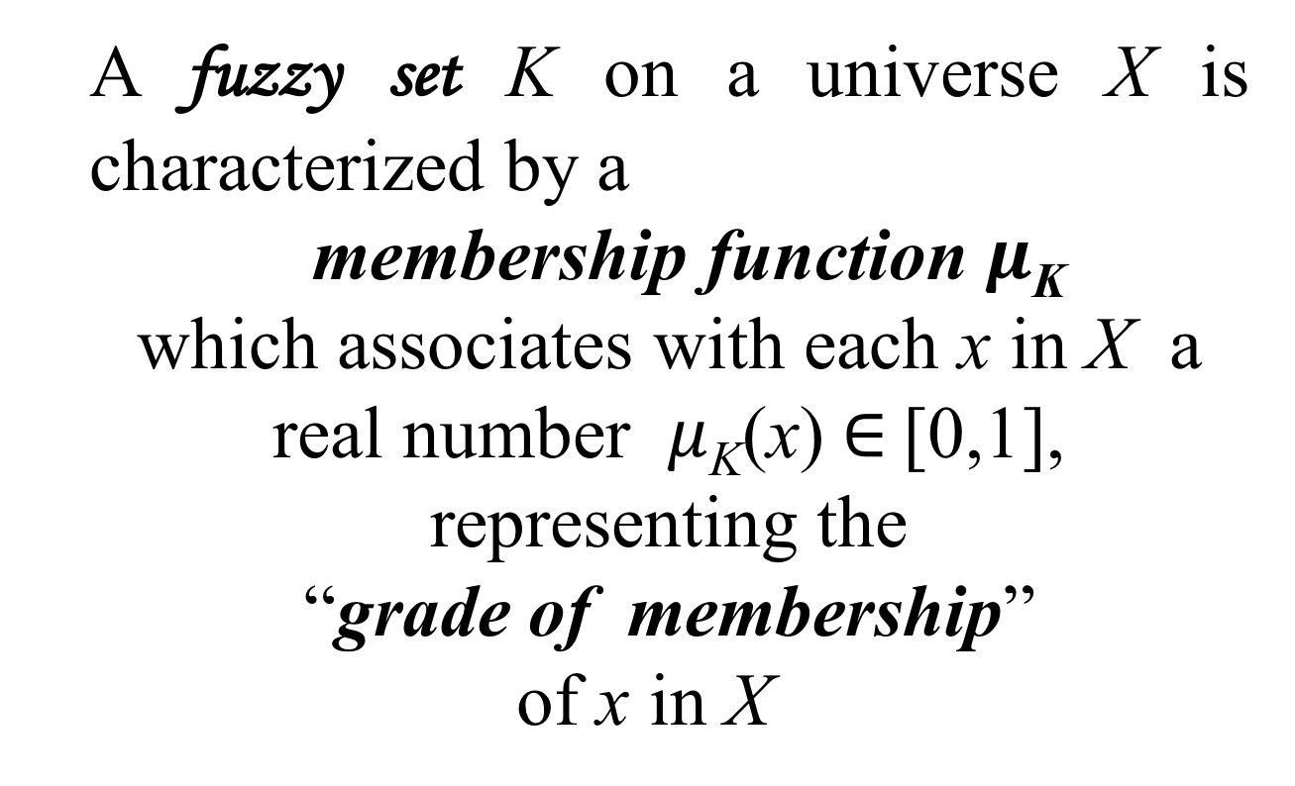
  A fuzzy set K on a universe X is characterized by a
  membership function $μ$_{K}
  which associates with each x in X a real number $μ$_{K}(x)$∈$[0,1], representing the
  “grade of membership”
  of x in X

Slide 16
Classical set ----- Hard – CRISP
Fuzzy set ----- Soft
µ_{A}(x) : degree of belonging of x to A or degree of possessing some imprecise property represented by A
The membership function can be
continuous or discrete

Slide 17
Example :
tall man, long street, large number, sharp corner, very young, etc.
Fuzzy set is a Generalization of classical set theory
Greater flexibility in capturing faithfully various aspects of incompleteness or imperfection in a situation.

Slide 18
Fuzzy Set Theory
– a paradigm shift of
Cantor (1845-1918) Set theory
Fuzzy Logic
– a paradigm shift of
Aristotle's Logic based
on Boolean Algebra
(due to George Boole (1815–1864)

Slide 19

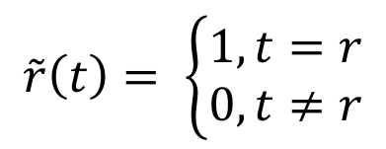

A Fuzzy Number is
a fuzzy analogue of the real No.
- a fuzzy set defined on ℝ
characterized by a membership
function A : ℝ $→$I (=[0,1])
The set of real numbers, ℝ ,
form the crisp set embedded in ℝ$($I )
$$\tilde{r}\left(t\right)= \left\{\begin{aligned}1, t=r \\ 0, t≠r\end{aligned}\right.$$

Slide 20
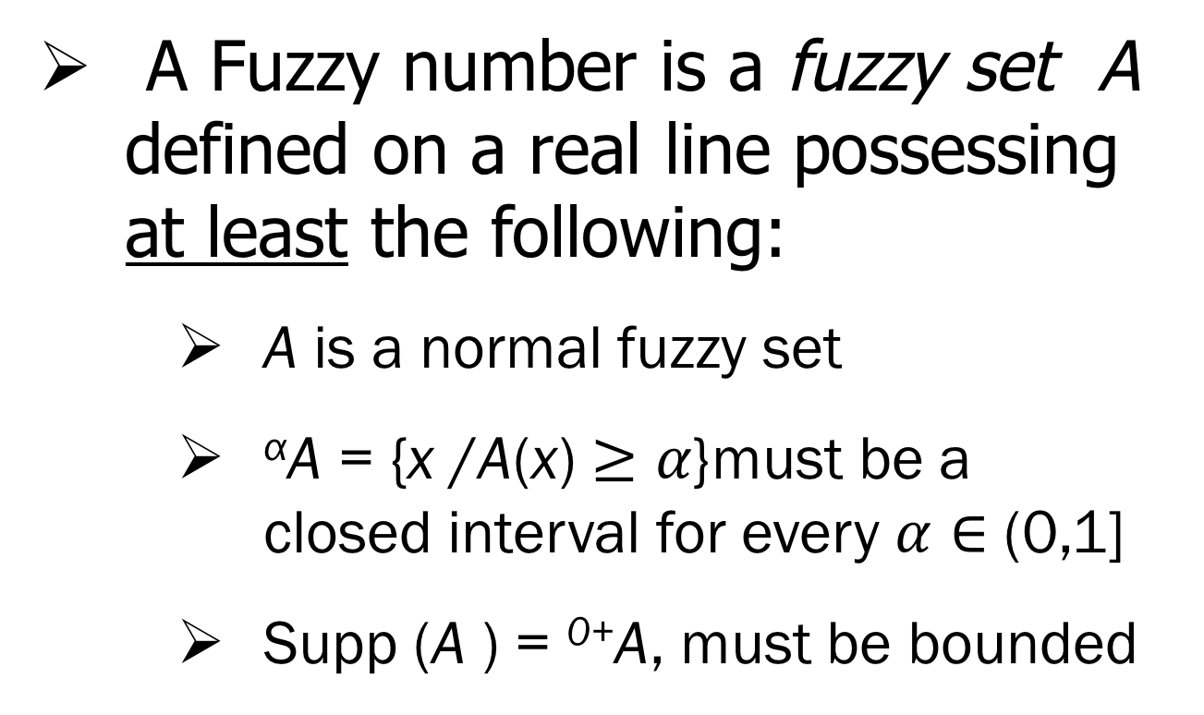
The Set of Real Numbers, ℝ , form The Crisp Set
A Fuzzy number is a fuzzy set A defined on a real line possessing at least the following:
    A is a normal fuzzy set
    ^{α}A = {x /A(x) $≥α$}must be a closed interval for every $α∈$ (0,1]
    Supp (A ) = ⁰⁺A, must be bounded

Slide 21
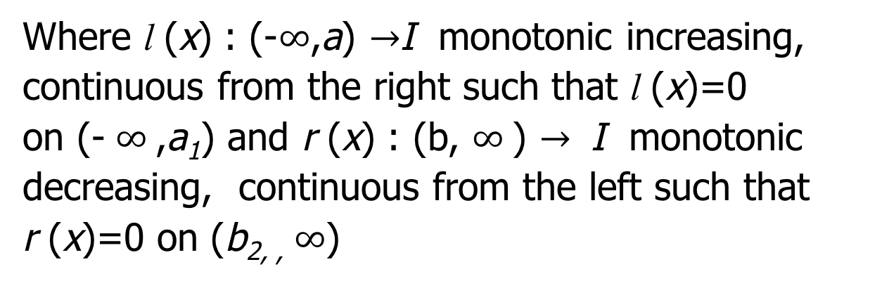

Representation Theorem
Let A $∈$ℱ (ℝ ). Then A is a fuzzy number iff there exists a closed interval [a,b] in ℝ such that
Where l (x) : (-$∞$,a) $→$I monotonic increasing, continuous from the right such that l (x)=0
on (- $∞$,a₁) and r (x) : (b, $∞$) $→$ I monotonic decreasing, continuous from the left such that r (x)=0 on (b_{2, ,} $∞$)

Slide 22
Every fuzzy number can be
represented by the above representation
In general this allows one to define
fuzzy numbers in a piecewise manner
A Fuzzy Number
Triangular
Fuzzy Number
Trapezoidal
Fuzzy Number

Slide 23
Crisp Number
Gaussian Fuzzy Number
Exponential Fuzzy Number
Quadratic Fuzzy Number

Slide 25
Triangular Fuzzy Number
Trapezoidal Fuzzy Number
Hexagonal Fuzzy Number
Octagonal Fuzzy Number

Slide 26
Linguistic variable | Linguistic Values
Speed | Fast, Medium, Slow
Temperature | Hot, Warm, Cold (High, Medium, Low)
Pressure | High, Medium, Low
Height | Tall , Medium, Short

Slide 27
ARITHMETIC OPERATIONS
on FUZZY NUMBERS
Arithmetic of fuzzy numbers
Interval
Arithmetic
Employing
Extension Principle

Slide 28
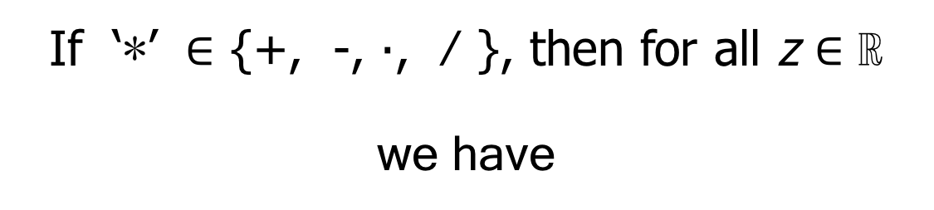
OPERATIONS
Employing Extension Principle
If ‘∗’ $∈$ {+, -, ∙, ⁄ }, then for all z $∈$ ℝ
we have
(A ∗B )(z) = Sup min {A(x), B(y)}
^{z = x ∗ y}
(A ∗B) is a fuzzy number

Slide 29
OPERATIONS
USING INTERVAL ARITHMETIC
( A ∗B )^{α} = A ^{α} ∗ B ^{α}
Where ‘∗’ : +, -, ∙, ⁄
( A ∗ B ) is a fuzzy number

Slide 30
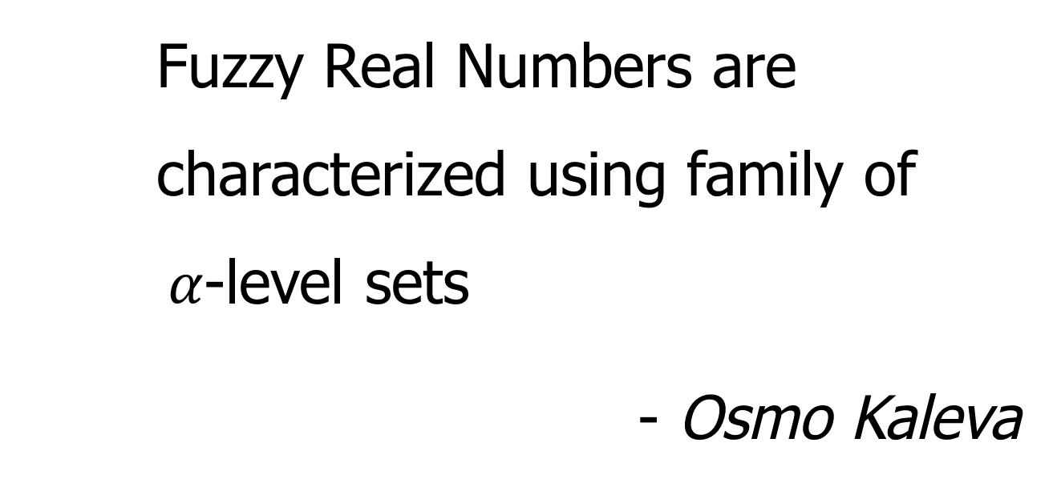
Fuzzy Real Numbers are characterized using family of α$α$-level sets
- Osmo Kaleva

Slide 31
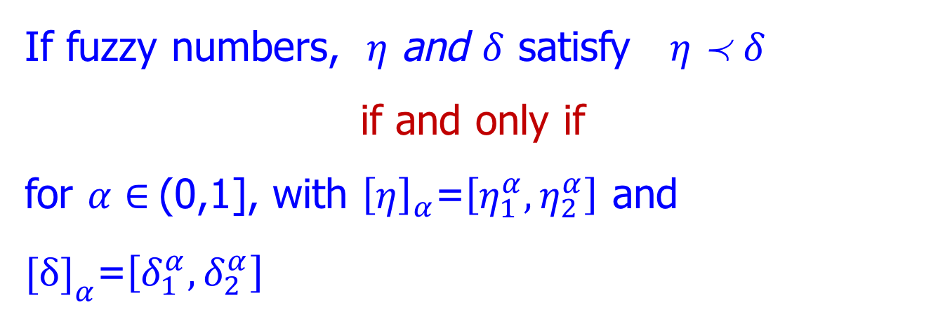
Order in Fuzzy Numbers- ℛ(I )
If fuzzy numbers, $η$ and $δ$ satisfy η$η$  $δ$δ
if and only if
for $α∈$(0,1], with ${\left[η\right]}_{α}$=$\left[η_{1}^{α},η_{2}^{α}\right]$ and ${[δ]}_{α}$=$\left[δ_{1}^{α},δ_{2}^{α}\right]$

Slide 32
Other Ordering Techniques
Ranking Techniques
for different type of fuzzy numbers

Slide 33
Fuzzy logic is many-valued logic in which the truth values of variables may be any real number between 0 and 1
It is employed to handle the concept of partial truth, where the truth value may range between completely true and completely false

Slide 34
Applications in the field of :
Fuzzy logic in Engineering & Neural Networks
Information System in –
- Fuzzy Pattern Recognition / Image
Processing
- Medicine
Decision Support
Fuzzy Control in - Industry
Medicine
Robotics / Space Research

Slide 35
BIOLOGICAL AND MEDICAL SCIENCE
(Med. diagnosis, ECG, X-ray analysis, Cancer,EEG)
LAW ENFORCEMENT
(Finger print, handwriting, photograph &
skull identification)
INDUSTRY
(CAD, CAM, Product testing & assembly,
Robot, Automatic inspection)
DEFENCE
(Target identification, guidance & control)

Slide 36
Fuzzy Control Systems
Examples
Coke Oven Gas cooking Plant
Water Purification
Temp. Control
Car Control by Oral Instructions
Combustion Control
Control Problem
Temp. Control,
Maintenance Guide
Chemicals addition
Self Regulation parameters
Fuzzy Algorithm due to Sugeno
Combustion Air Flow

Slide 37
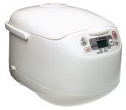
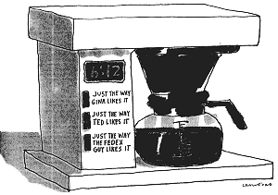
FUZZY LOGIC in
Household Appliances
Coffee Maker
using Fuzzy Logic
Fuzzy Logic 10 Cup
Rice Cooker and Warmer
(Zojirushi NS-MYC18 Micom)

Slide 38
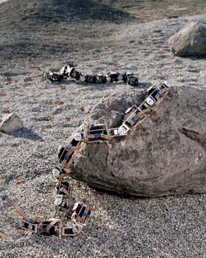
Snakebot

Slide 39
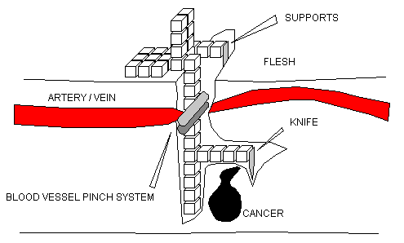
Fractal Surgeon

Slide 40

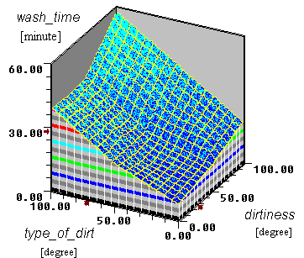
Fuzzy Washing Machines
Block Diagram & Input / Output Response

Slide 41
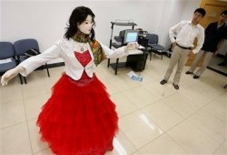
Robotics
Miss Rong Cheng,
Chinese humanoid Robot, Museum tour-guide,
Sichuan Science Museum, China

Slide 42
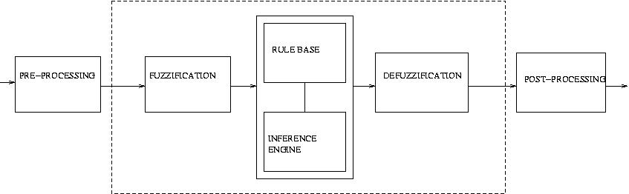
Block Diagram of a Fuzzy Controller

Slide 43
Preprocessing
The inputs are crisp rather than linguistic.
A quantiser is required to convert the incoming values to find the best level in a discrete universe.
E.g. Input variable level = 4.35, universe u is (0,1,…,5). The quantiser rounds it to 4.

Slide 44
Fuzzification
1st block inside the controller.
Converts input data to degrees of membership by lookup in various membership functions.
Determines how well the condition of each rule matches that particular instance.

Slide 45
Rule Base
Usually in an if-then format.
E.g. Inputs – error, change in error.
Rules : IF error is _ AND change in error is _ THEN output is _ will give 9 inferences.
Change in error
 | Neg | Zero | Pos
Neg | NB | NM | Zero
Zero | NM | Zero | PM
Pos | Zero | PM | PB
Error

Slide 46
Inference Engine
Aggregation : This operation is use to find the degree of fulfillment α_k of the condition of a rule k
The aggregation of µ_e (fuzzy membership in the set error) and µ_ce (from change in error) is µ_e and µ_ce
Activation : Activation of a rule is the deduction of the conclusion – min is used as the activation operator
Accumulation : All activated conclusions are accumulated, using the max operation

Slide 47
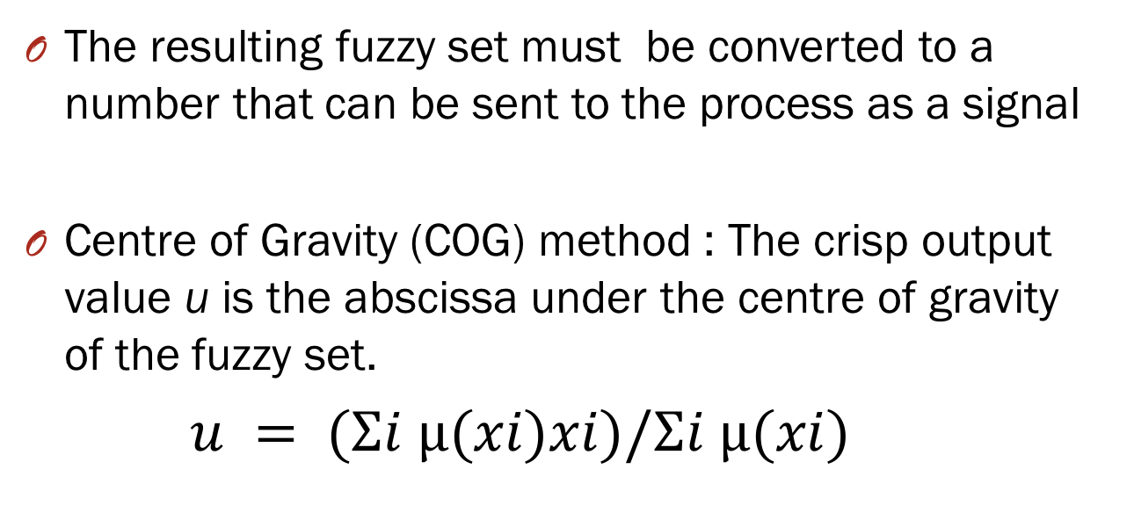
Defuzzification
The resulting fuzzy set must be converted to a number that can be sent to the process as a signal
Centre of Gravity (COG) method : The crisp output value u is the abscissa under the centre of gravity of the fuzzy set.
$u = (Σi µ(xi)xi)/Σi µ(xi)$

Slide 48
Fuzzy Logic in Components of
Traffic Control Systems
Intelligent
Control
Analyse Weather Condition
Incident Detection Traffic Flow Analysis
Signal Analysis at Induction Sensors
Supervise Field Equippment

Slide 49
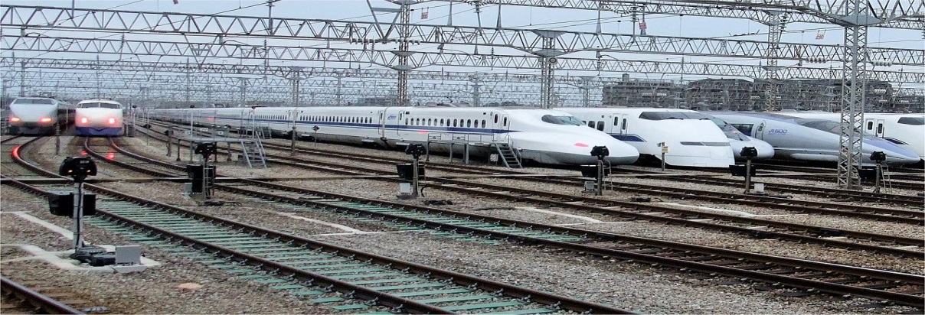
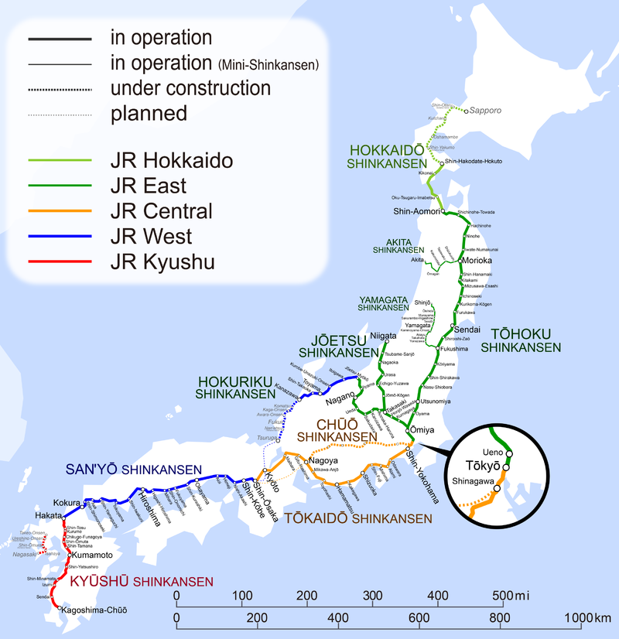
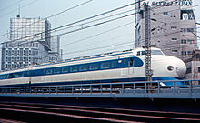
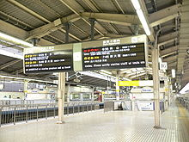
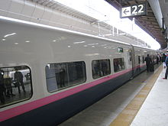
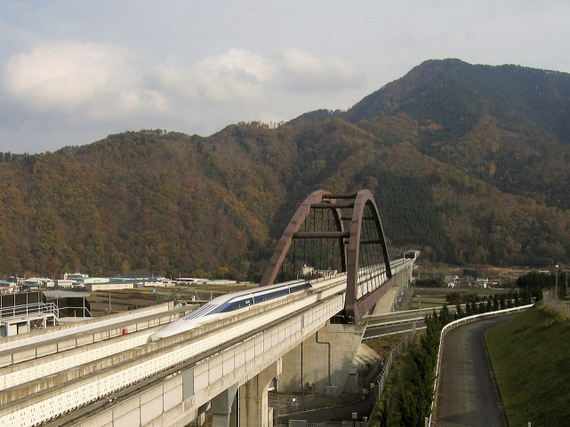

JR – Shinkansen : Japan

Slide 50
TRAFFIC FLOW AT SIGNALISED
INTERSECTION
J. of Combinatorics, Information & System Sciences
Vol. 33 (2008) Nos. 1-2, pages 99-109
NETWORKING OF TRAFFIC FLOW FOR TWO ADJACENT SIGNALISED INTERSECTIONS
Presented at RACT 2010
Dr. Felbin C. Kennedy
(with Dr.Mercy Soruparani)

Slide 51
TRAFFIC FLOW
AT A
SIGNALISED INTERSECTION

Slide 52
TRAFFIC FLOW AT SIGNALISED INTERSECTION
The performance of a traffic system, which consists of Network Topology, is shown to depend on the traffic control system involving the signalised intersection consisting of
- the flow of traffic that can happen
simultaneously decided through networking
  - the signal timings calculated through fuzzy
  controller taking inputs from detectors which are placed upstream of the traffic flow
The difference between pre-timed and vehicle actuated signal for a specific locality in Chennai city is modeled through simulation

Slide 53
A Case Study
Topography of a signalized intersection Simulation
- Predetermined
- Vehicle actuated

Slide 54
Topography of a Signalized Intersection
McNicol’s
Road
Harrington Road
Spur Tank Road
Sterling
Road

Slide 55
Need for Traffic Light
right of way in the intersection
increase in number of vehicles
demands traffic control regulation
to ensure safety
to preserve order

Slide 56
SIGNALISED INTERSECTION
Need
- Safety
Regulation of Traffic flow
- Optimized
- Minimum waiting time

Slide 57
SIGNALISED INTERSECTION
Three - road intersection
Mathematical Model Representation
Four - road intersection
Mathematical Model Representation

Slide 58
Three - road intersection
(1) AC - BA & CB
(2) BA – AC & CB
(3) CB – AC & BA
B
A
C
Non Compatible Turns

Slide 59
Network representation - Single Solution
1
2
(1)AC - BA & CB
(2)BA – AC & CB
(3)CB – AC & BA
3
B
A
C

Slide 60
Non Compatible Turns
AC – BA, BD, CB & DB
AD – DB, CA, DC & BA
CA – AD, BD, DB & DC
CB – AC, DC, CB & CA
B
A
C
D

Slide 61
Signal Pattern
B
A
C
D

Slide 62
Signal Pattern
B
B
A
C
A
C
B
D
D
B
A
C
A
C
D
D

Slide 63
Network representation : Solution - 1
1
2
8
3
7
4
6
5

Slide 64
Network representation:
Solution - 2
1
2
8
3
7
4
6
5

Slide 65
Signal Problem - (constraints)
Minimum waiting time
Sufficient (minimum) green time
Maximum green time
Single queue (unitizing)
Pedestrian crossing
Need for Fuzzy
Each intersection is different

Slide 66
Phases of Signal
The signal cycle will be -
< Red – Amber - Green – Amber >
Signal timing for the green and the red
phase could be either predetermined or
vehicle actuated
A terminal has two sets of separate
calculations for red and green timing

Slide 67
Data – Chennai Traffic Police (North)
Chetpet point on 02.08.2006
Sterling Road →Mc Nicols

Slide 68
Time Function - green time upper limit
The maximum duration for green signal
need to vary according to the traffic intensity
Traffic intensity could be considered as lean
or heavy
The central limit theorem gives the upper
and lower limits of the traffic intensity

Slide 69
Module of signalized intersection
The requirement of Membership functions are three fold
Time function
Red Time function
Green Time function

Slide 70
Time Function –
Fuzzy representation
Lean Heavy
1
0
1960
2071
2182
2293
2404
Number of vehicles in 30 min.

Slide 71
Red Phase
Signal time is determined by green phase of
the previous terminal
Detector gives queue length as input
Queue = initial queue + no. of approaching vehicles
Time function determines the max green time
Fuzzy membership function will calculate
the initial green time

Slide 72
Fuzzy Membership Function - Vehicle Queue
Zero : μ =1, q ≤= 2
  Small : μ =1, 6 < q < 10
    μ = ( q – 2)/5, 2< q <6
  Medium: μ =1, 14 < q < 20
    μ =( q – 10)/5, 10< q <14
  Big : μ =1, 26 < q
    μ =( q – 20)/7, 20< q <26

Slide 73
Fuzzification
Zero Small Medium Big
(10 sec) (20 sec) (45 sec)
1
0
4 6 10 14 20 26 28 …
Fuzzy Membership function - Vehicle Queue

Slide 74
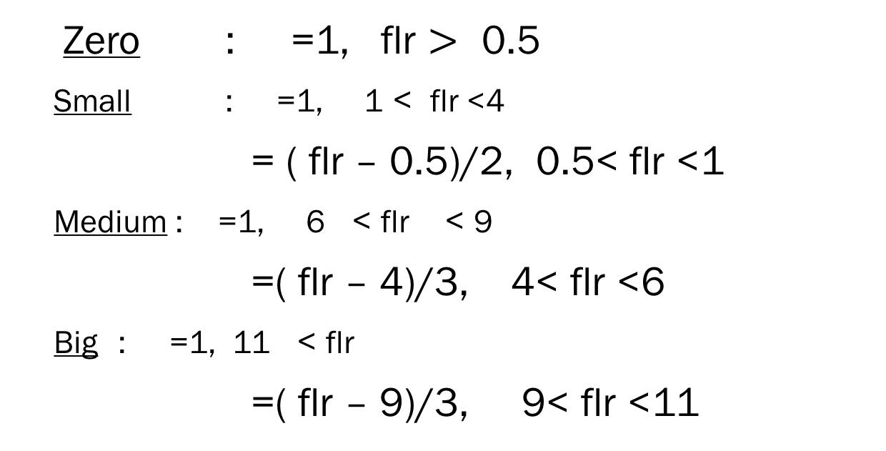
Fuzzy Membership Function –
Vehicle Flow
Zero : μ =1, flr $>$≤0.5
  Small : μ =1, 1 < flr <4
    μ = ( flr – 0.5)/2, 0.5< flr <1
  Medium : μ =1, 6≤ < flr ≤ < 9
    μ =( flr – 4)/3, 4< flr <6
  Big : μ =1, 11≤ < flr
    μ =( flr – 9)/3, 9< flr <11

Slide 75
Fuzzification
Zero Small Medium Big
(3 sec) (9 sec) (12 sec)
1
0
0.5 1 4 6 9 11 …
Fuzzy Membership function - Vehicle Flow

Slide 76
Initial Green time
Green time = membership function - μ
Zero : 0 sec
Small : 0 – 10 sec
Medium : 10 – 40 sec
Big : 40 – 45 sec

Slide 77
Green Phase
Initial queue length
Initial and maximum signal time.(small:10 & 20)
Vehicle flow = no. of approaching vehicles/time
Time to be extended or terminated
Current queue =
initial queue + no. of approaching
Vehicles – discharge
Fuzzy Membership function for Vehicle Flow

Slide 78
Green Phase Timing Calculation
If G_{T} is initial Green Phase then if
is G_{T} +E_{T}
then the extension is E_{T}
else it is

Slide 79
Green Phase Timing Calculation
In case E_{T ‘} was the selection made in the previous step, after ∆t seconds we have if
is G_{T} +E_{T}+ E_{T’} then the extension is E_{T’}
else it is until

Slide 80
Time to be extended
where P is the time required for maximum approach flow in ∆t seconds

Slide 81
Time to be extended
Time extension = membership function -
Zero : 0 sec
Small : 03 – 06 sec
Medium : 06 – 09 sec
Big : 09 – 12 sec

Slide 82
TRAFFIC FLOW AT SIGNALISED INTERSECTION
The performance of a traffic system, which consists of Network Topology, is shown to depend on the traffic control system involving the signalised intersection consisting of
- the flow of traffic that can happen
simultaneously decided through networking
  - the signal timings calculated through fuzzy
  controller taking inputs from detectors which are placed upstream of the traffic flow
The difference between pre-timed and vehicle actuated signal for a specific locality in Chennai city is modeled through simulation

Slide 83

Chetpet junction
&
the adjacent intersection
McNicols road
Gengu Reddy road
Maximum flow
Maximum flow
Spur tank road
Harrington road
Minimum flow
Sterling road
Casa major road

Slide 84
FUZZY MATHEMATICS :
THE RULER OF
THE UNIVERSE
Thank you

